Slide 1

Lessons from non-formal learning and teaching

Slide 2





(Vinc)enza Colonna
2007-2010 Lecturer Universita’ di Ferrara
Biological Databases, Genetics
2016- Collaboration with Elixir-ITA training activities
2016- Certified instructor for Software Carpentry/Data Carpentry
2014- Coordinator of Obilab: local project for training in bioinformatics

Slide 3

Courses 2015
Gene Expression profiling with HTS: RNA-Seq data analysis – CINECA Rome - 19-22 October 2015
Protein Networks and Systems Biology, Università di Bologna, 14-18 December 2015
High Throughput Sequencing (HTS) data analysis – Sapienza Università - 5-7 October 2015
NGS for evolutionary biologists: from basic scripting to variant calling – CINECA Rome - 23-27 November 2015
http://bioinformaticstraining.pythonanywhere.com
elixir.ita.training@gmail.com

Slide 4
Courses 2016
High Performance Molecular Dynamics@CINECA - PRACE Edition
CINECA, Bologna - 20-30 September 2016
High Performance Molecular Dynamics
CINECA, via dei Tizii 6, Rome - 5-7 April 2016
Effective academic teaching
University of Salerno, Fisciano (SA), Italy - June 15th, 2016
NGS for evolutionary biologists: from basic scripting to variant calling
Consiglio Nazionale delle Ricerche, Naples - May 2-6, 2016
RNA-seq data analysis
University of Naples Federico II, Naples - June 6-10, 2016
http://bioinformaticstraining.pythonanywhere.com
elixir.ita.training@gmail.com

Slide 5
Disclaim
The following examples are from the practical courses of ELIXIR-ITA in 2015-2016
Application to university courses
might require adjustments !!!

Slide 6
Active Learning in practice:
Before the class
During the class
After the class

Slide 7
Teacher (coach) motivation
Ask yourself why do you want to teach:
→ Obvious if your main appointment is teaching (e.g. professors at university)
→ Less obvious otherwise (e.g. volunteer teaching)
Active learning in practice: Before the Class

Slide 8
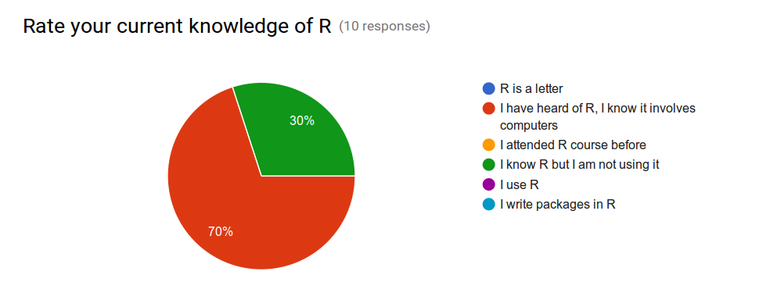
Know your students before you meet them
Select carefully, use pre- assessment forms
Active learning in practice: Before the Class

Slide 9
The more (instructors) the merrier
Aim for small size courses (max 25 students)
Instructor / students → 1 / 4-5
Expert students as helpers
Active learning in practice: Before the Class

Slide 10
Course Material
Establish and announce goals for the course and for single lessons
Make course material complete and available before the course starts
Example material
Active learning in practice: Before the Class

Slide 11
Active Learning in practice:
Before the class
During the class
After the class

Slide 12
Introduction and motivations
Let students and instructors introduce themselves and explain motivations
Set an informal atmosphere, use names, tricks to remember names
Active learning in practice: During the Class

Slide 13
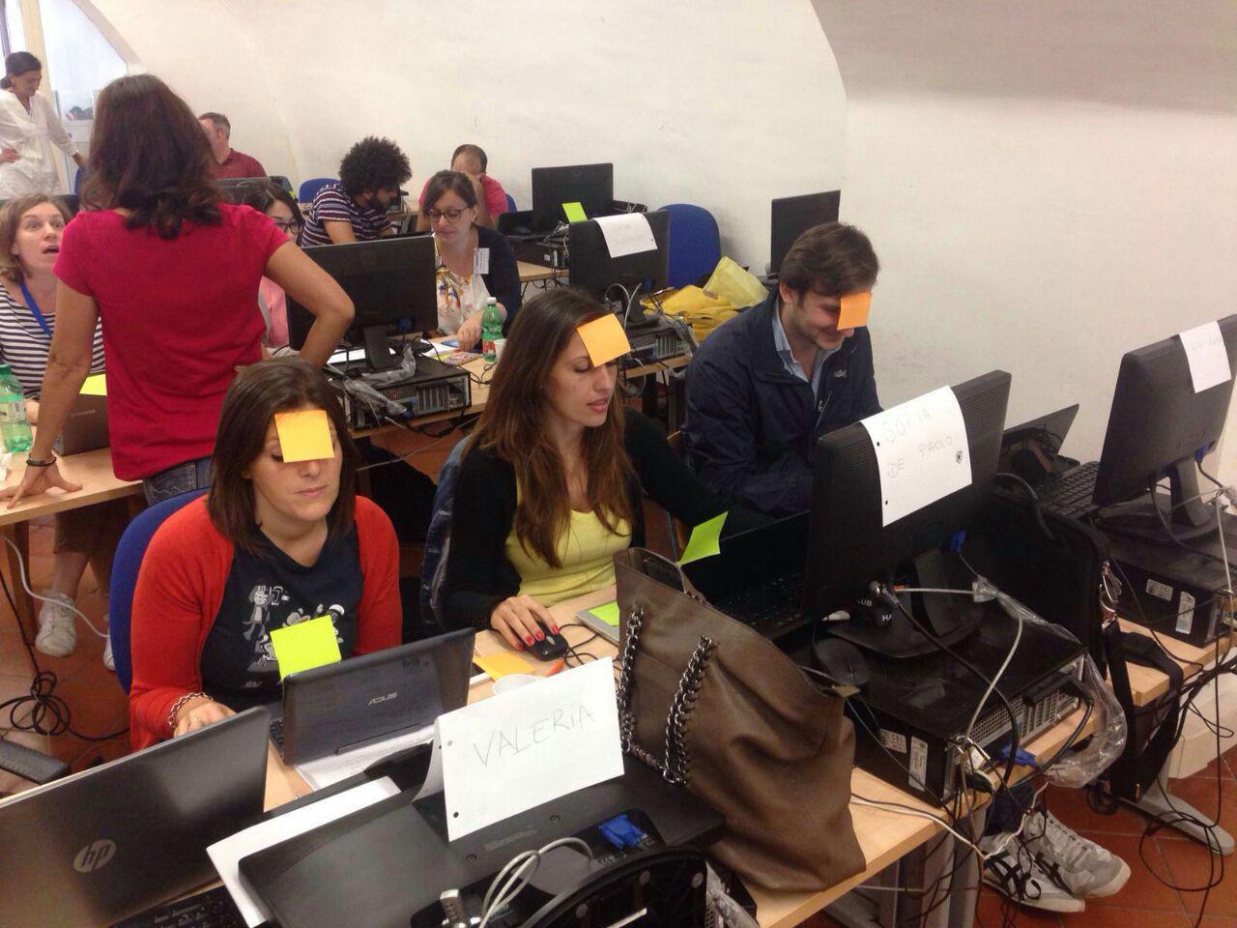
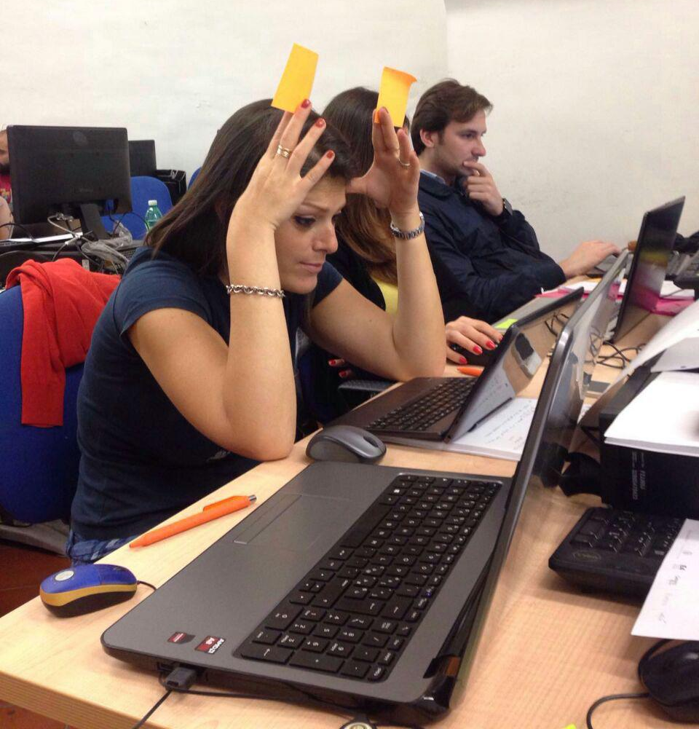
Sticky notes
Active learning in practice: During the Class

Slide 14
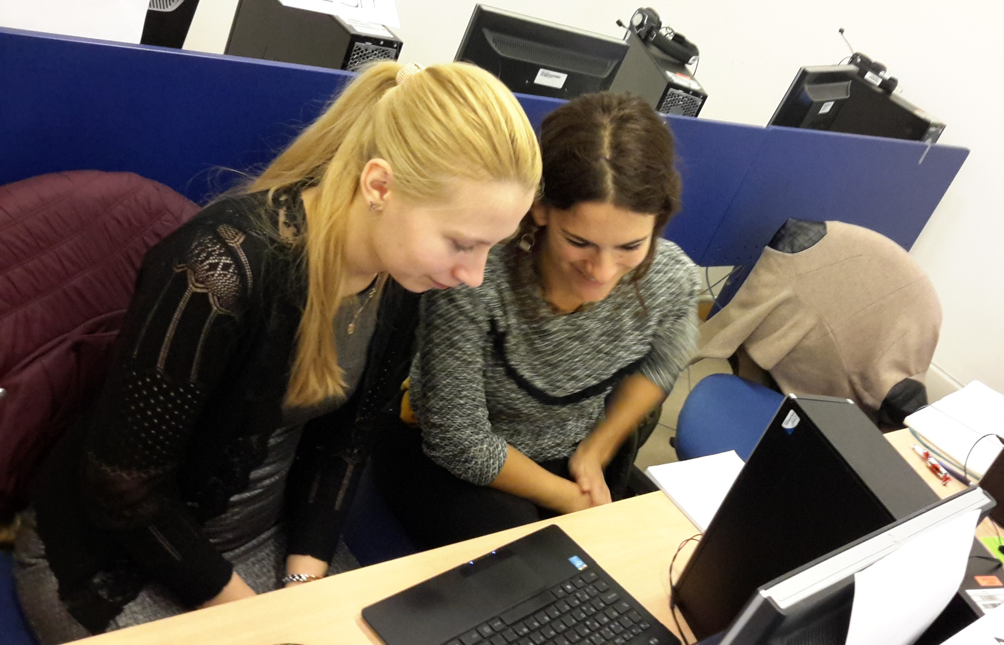
Peer -learning
Pair students according to expertise:
1 expert
1 non-expert
Active learning in practice: During the Class

Slide 15
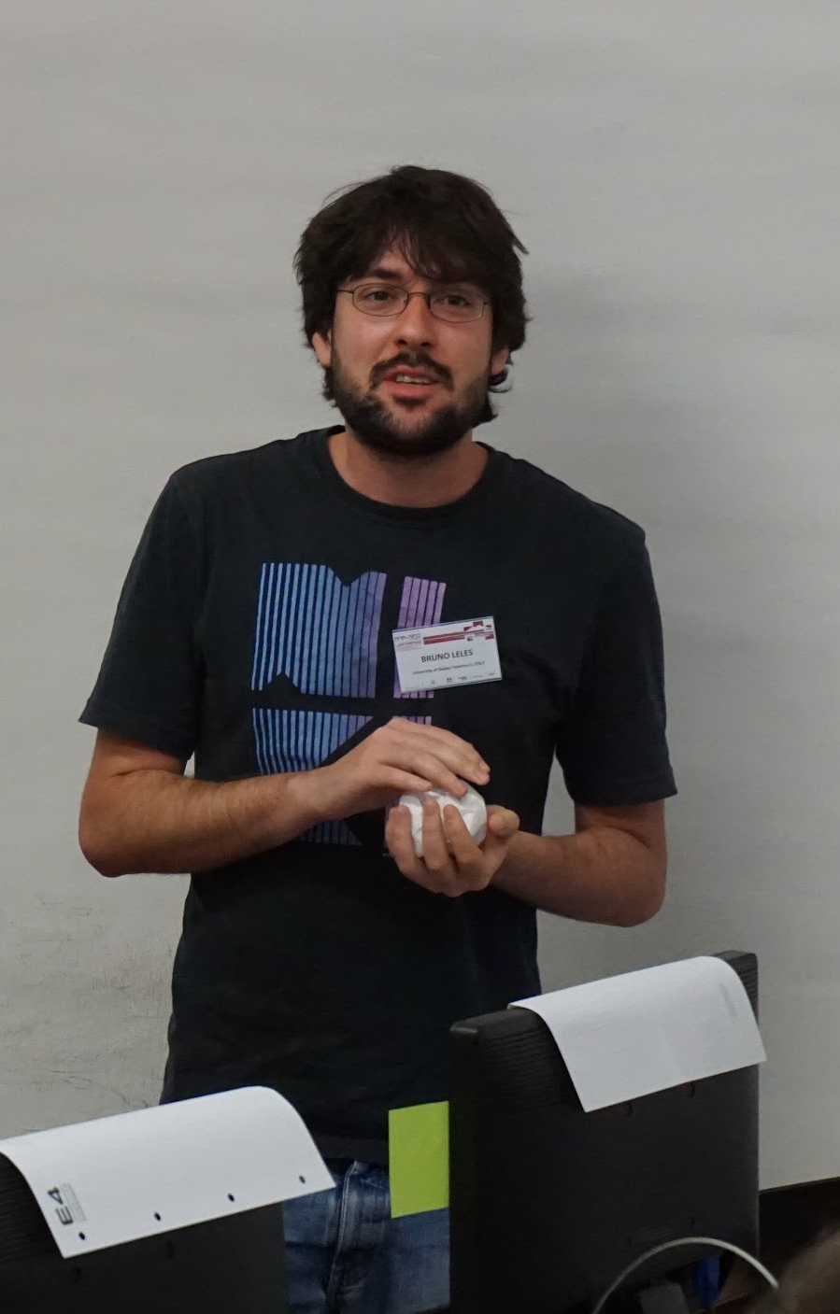
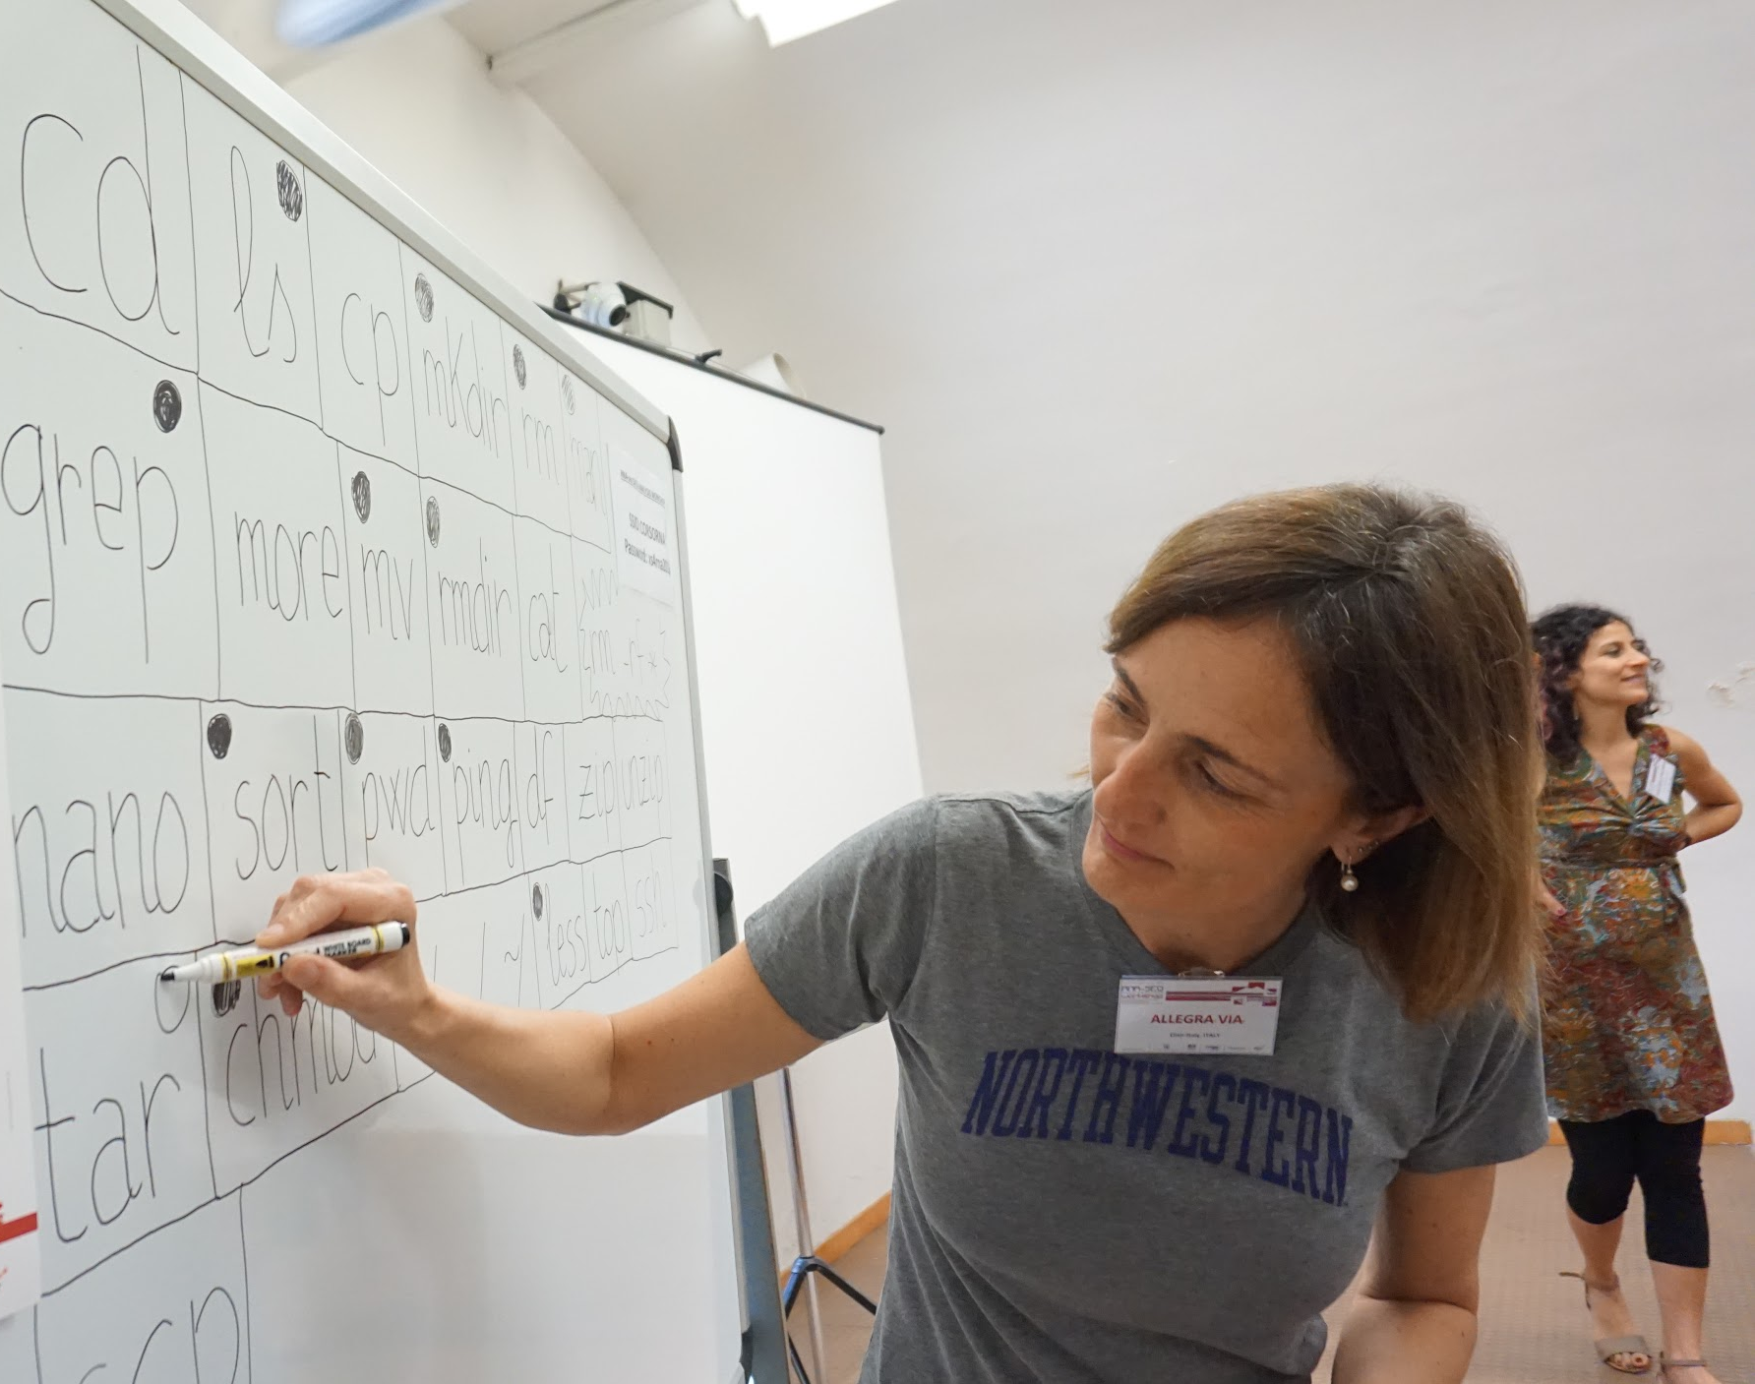
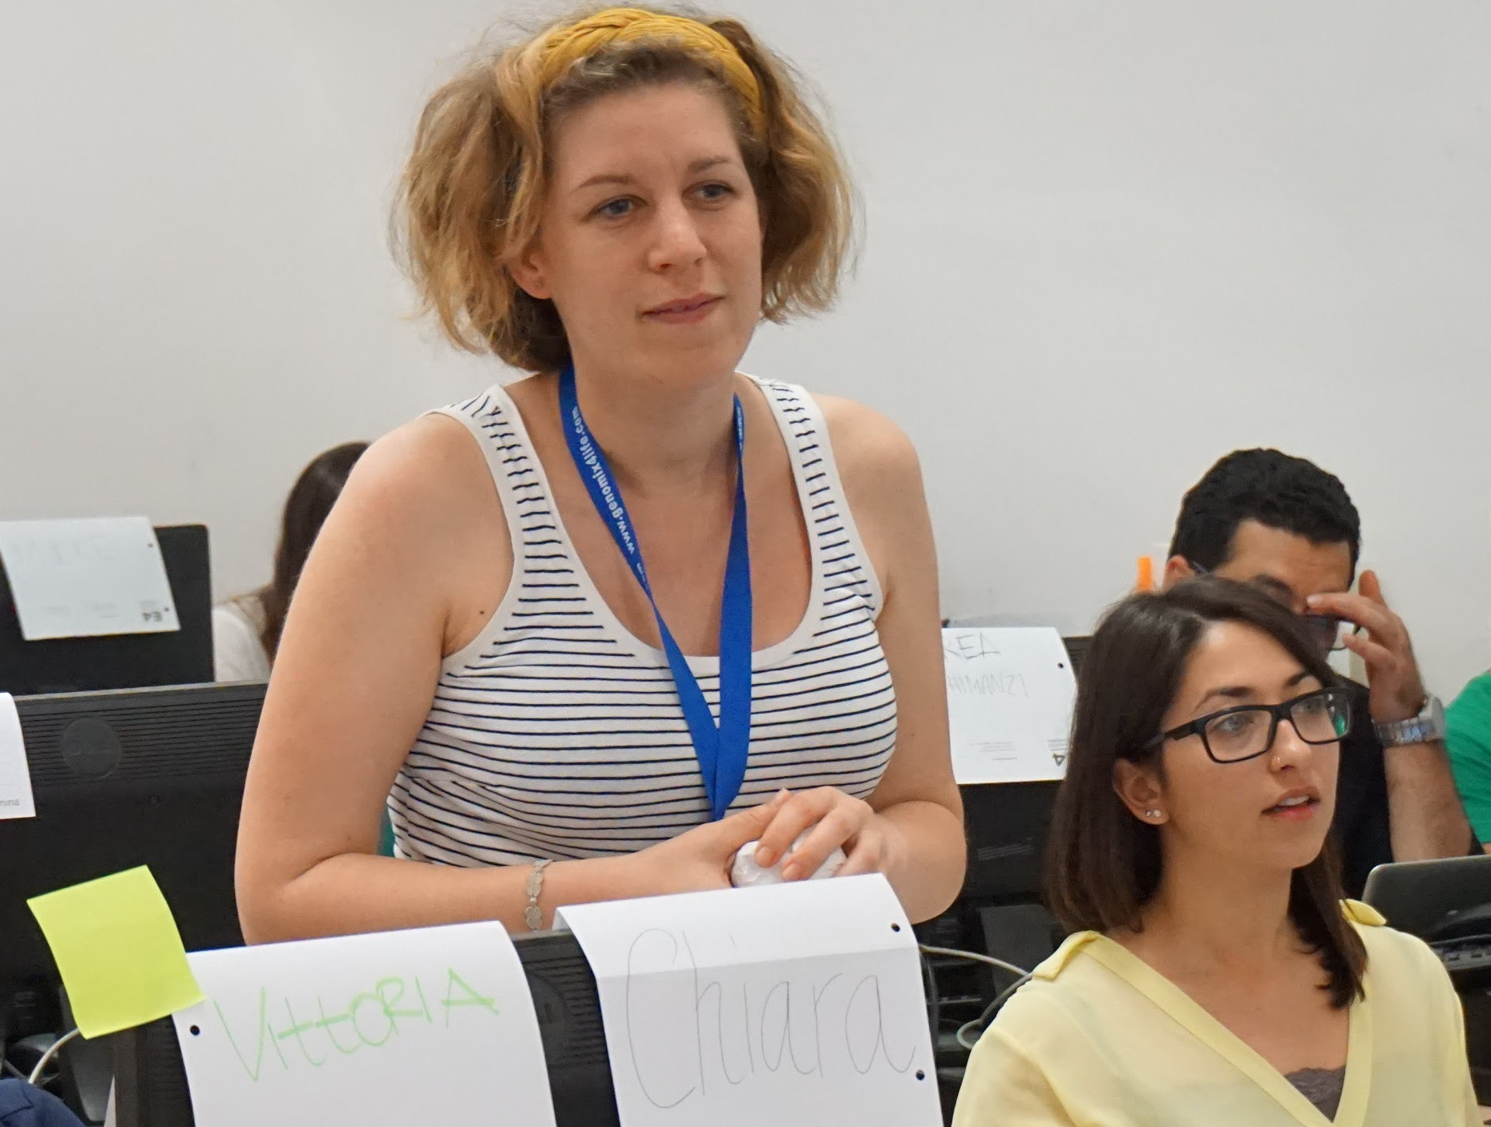
Recap ball
Active learning in practice: During the Class

Slide 16
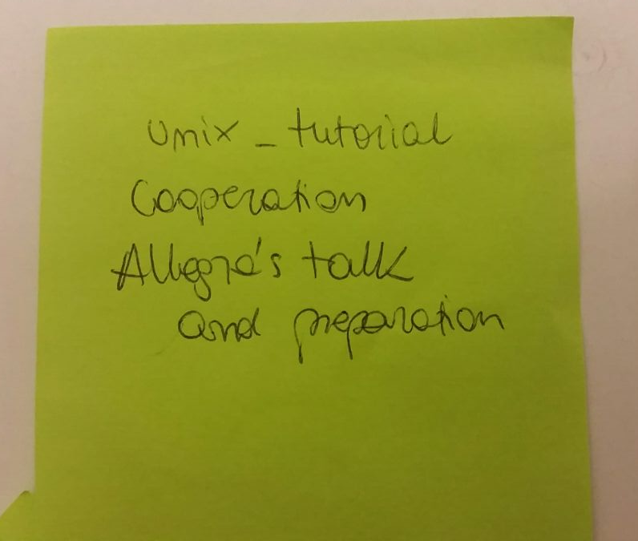
Daily feedbacks
1 positive thing
1 negative thing
Daily!!
Active learning in practice: During the Class

Slide 17
Practical projects to be done in groups
Group participants in groups of 3-4
Assign practical project similar to practicals learned alone
At the end of the course students present the results of the projects
Active learning in practice: During the Class

Slide 18
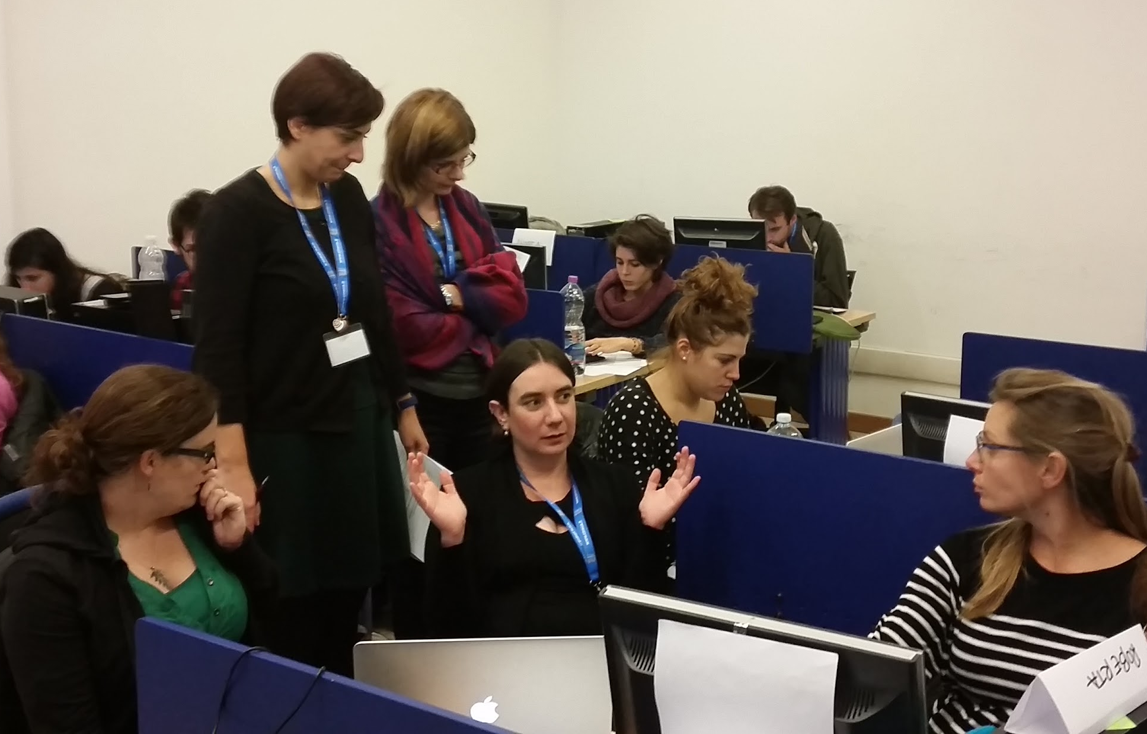
Projects: group discussion
Challenges with problems to be solved in groups
Active learning in practice: During the Class

Slide 19
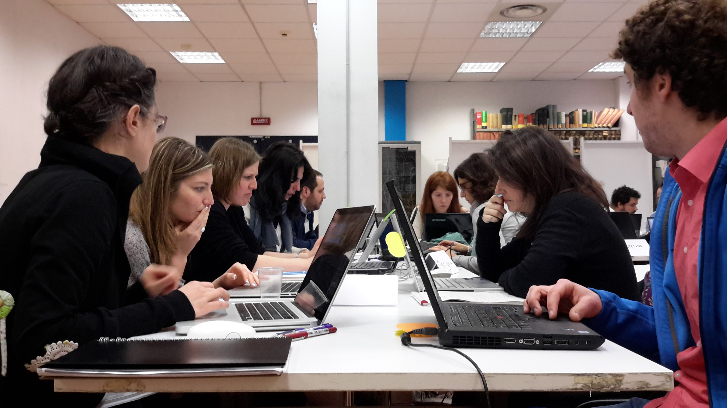
Projects: group work
Make complementary tasks
Active learning in practice: During the Class

Slide 20
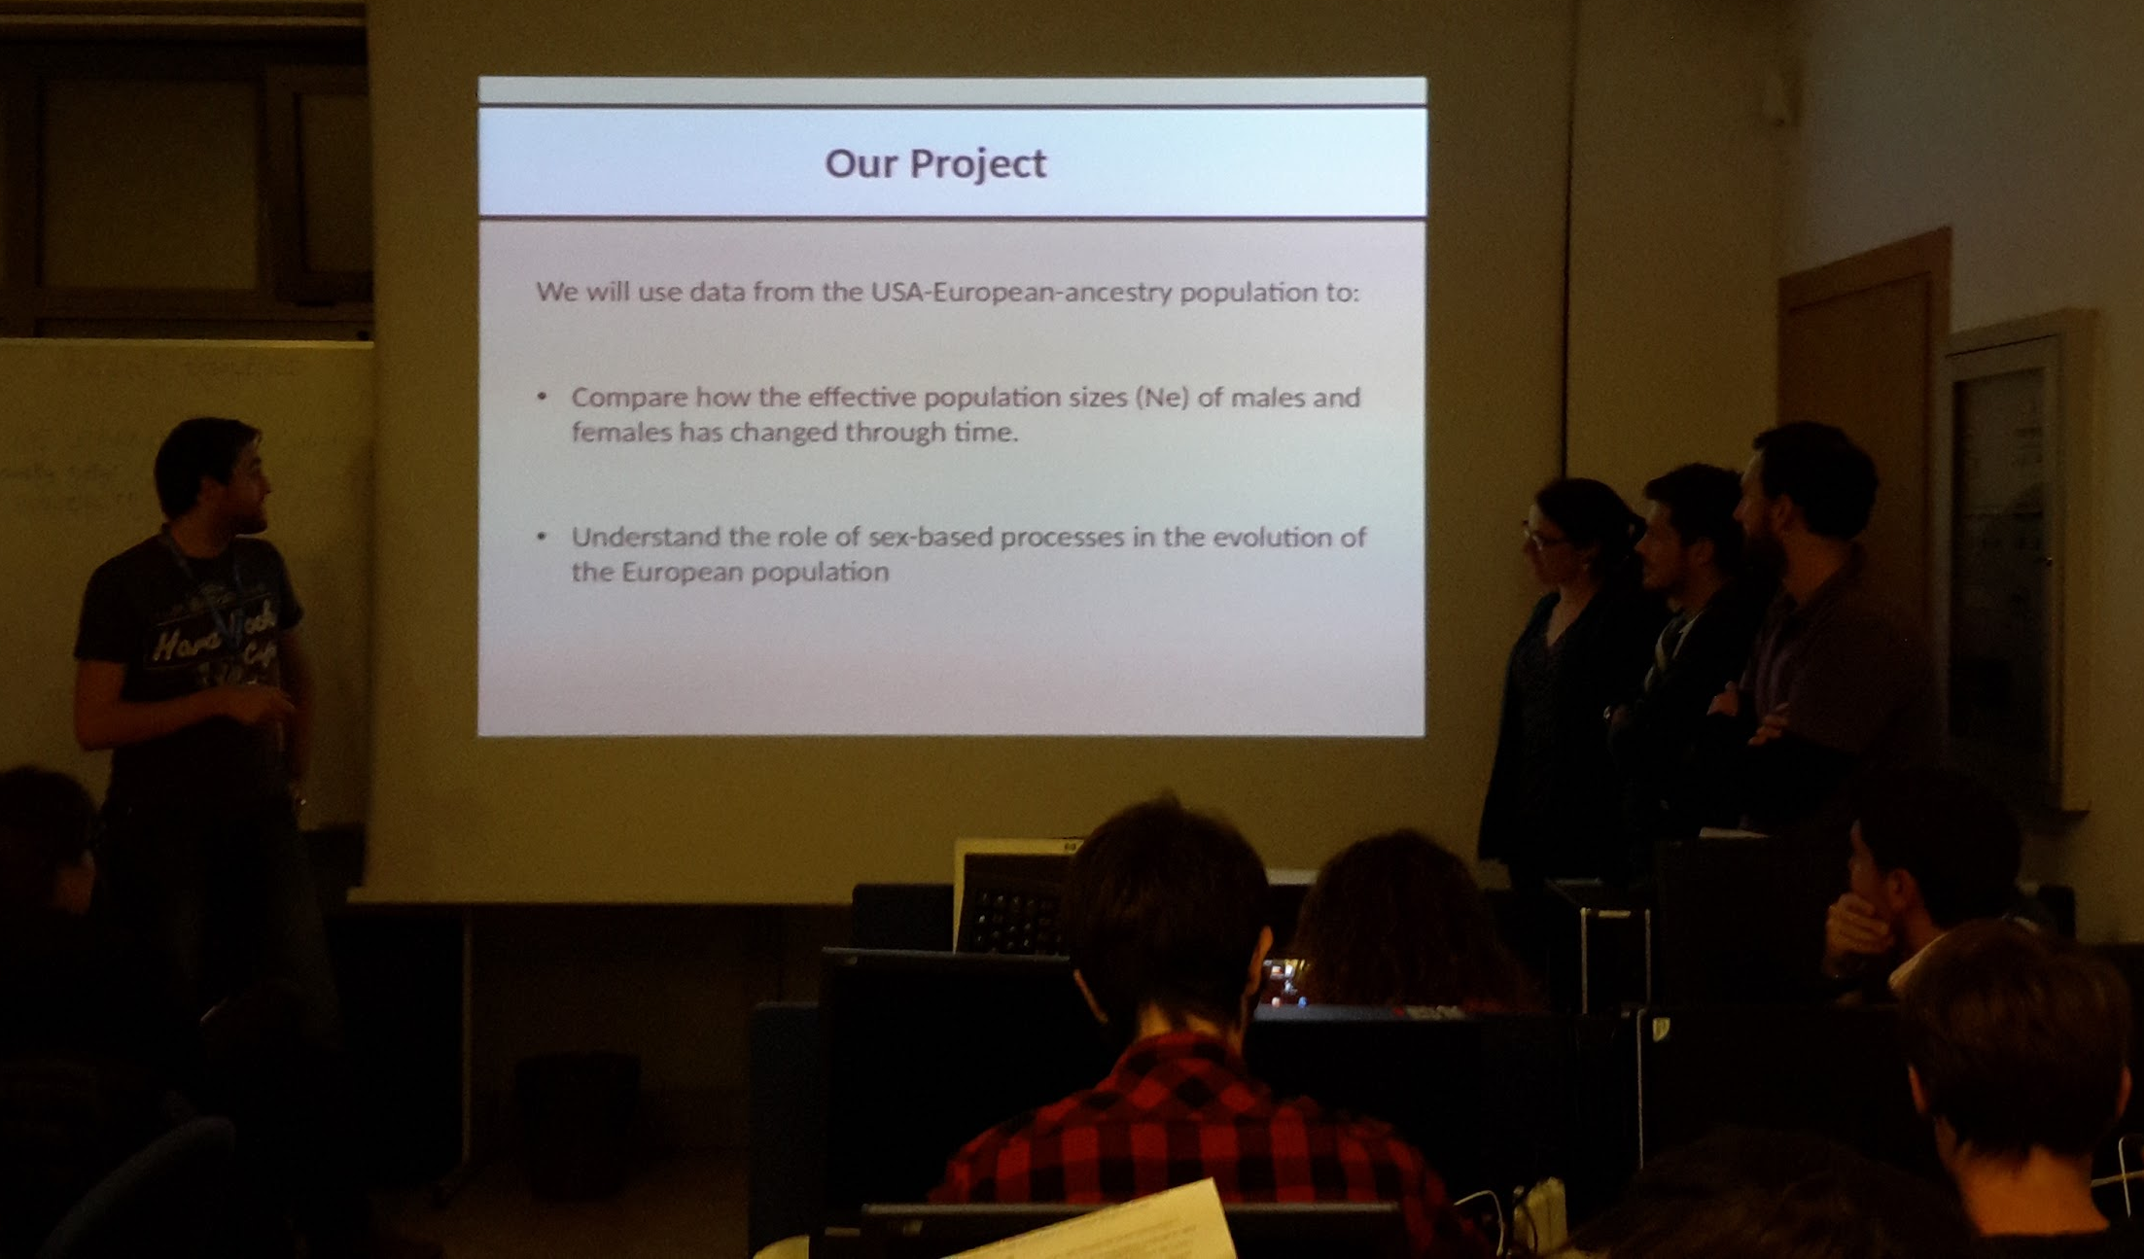
Projects: results presentation
Active learning in practice: During the Class

Slide 21
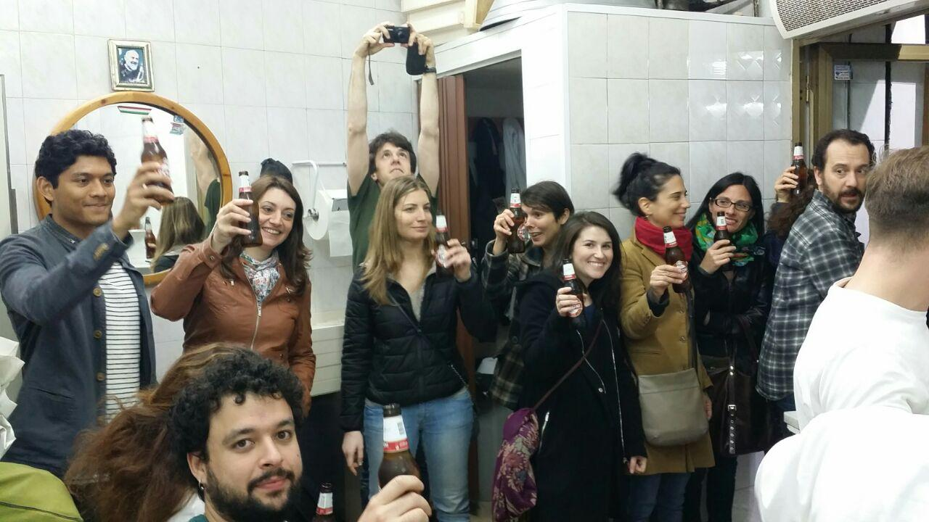
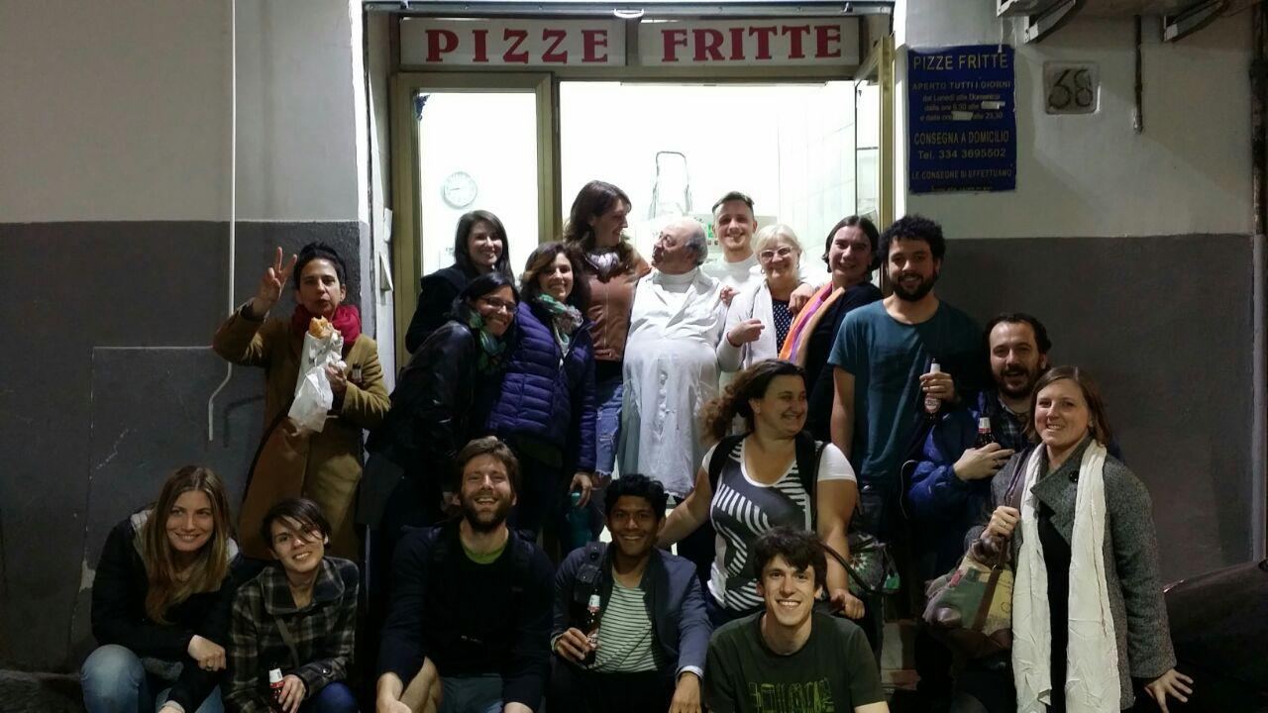
Social Activities
Active learning in practice: During the Class

Slide 22
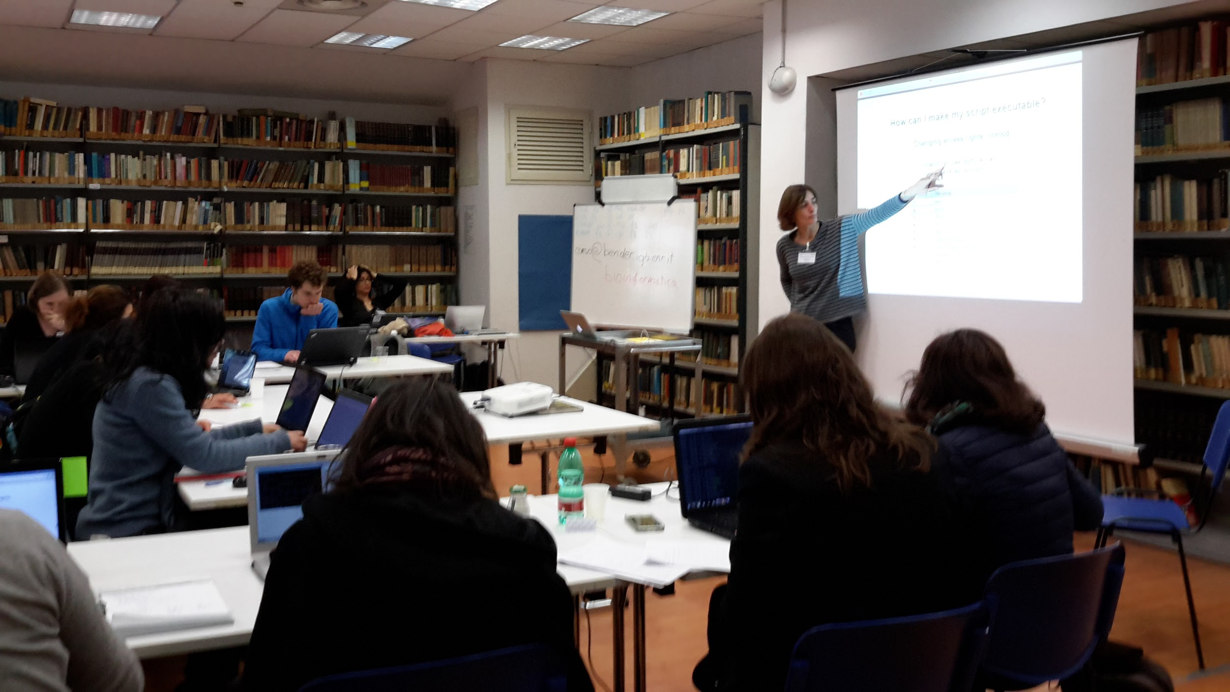
Occasionally lecturing…
Active learning in practice: During the Class

Slide 23
Active Learning in practice:
Before the class
During the class
After the class

Slide 24
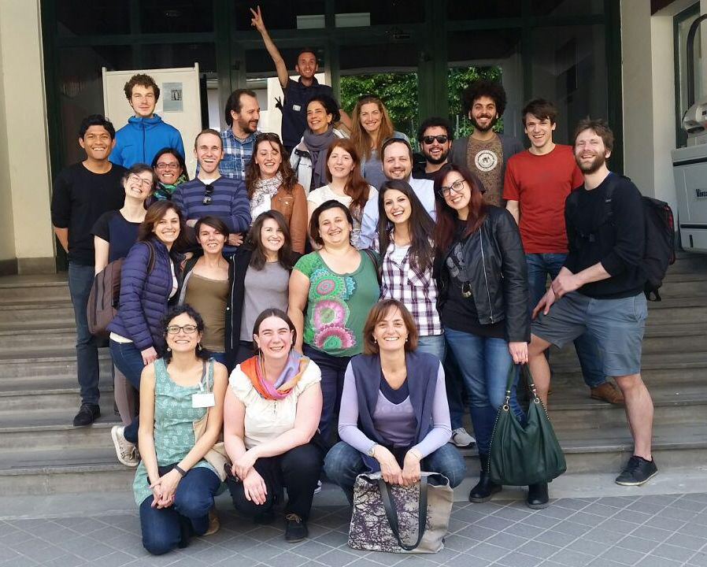
Feedbacks from students
Before students leave
Discuss the outcome in the class
Example form
Active learning in practice: After the Class

Slide 25
Instructors recap meeting
Right after the end of the course
Instructors will be exhausted at the end...
.... but it is the most effective time for recap!!
Active learning in practice: After the Class

Slide 26
Thank you

Slide 27
ELIXIR-ITA
Train the Trainer @BITS 2016

Slide 28
What you have to be aware of
1.It takes more time than you think
2.Use other people's stuff!
3.Expect push-back from students – Sitting through a lecture is easy. Learning is hard.
4.Keep your options open! You don't have to flip every lesson. Pick a few lessons each year.
5.Have a plan for your extra class time! Make sure you plan out how you will use your class time.

Slide 29
Your commitment
Actively help TtT:
Choose one (or more than one) approach discussed today
Apply it to your courses next year
Discuss the outcome with ELIXIR-ITA: we will appreciate your thoughts

Slide 30
Your commitment
2. Spread the news!!
Tell your colleagues to attend next TtT events
Invite colleagues to use active learning
Discuss introducing active learning in academic curricula

Slide 31
Thank you

